Slide 1

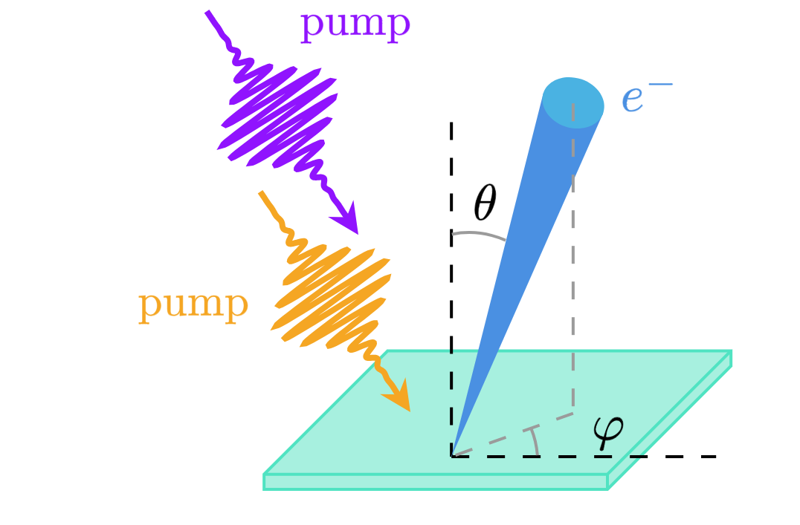
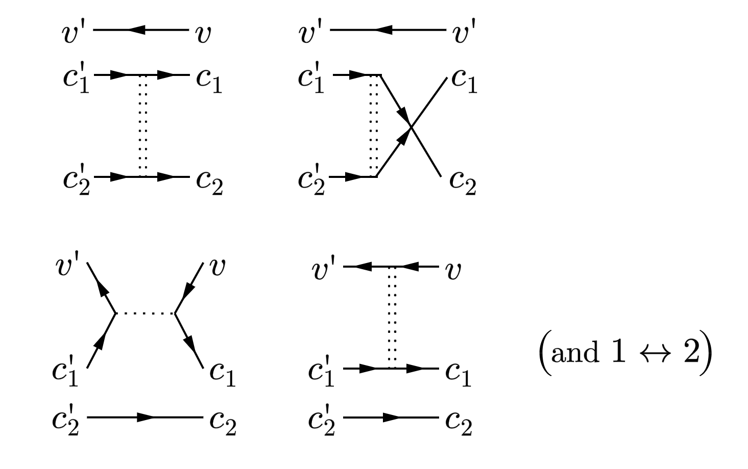
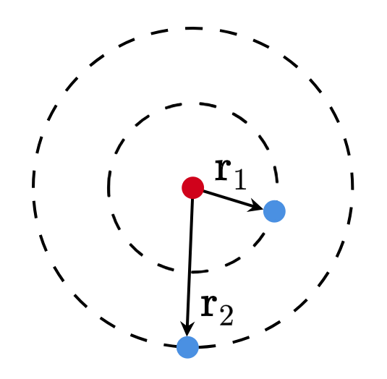
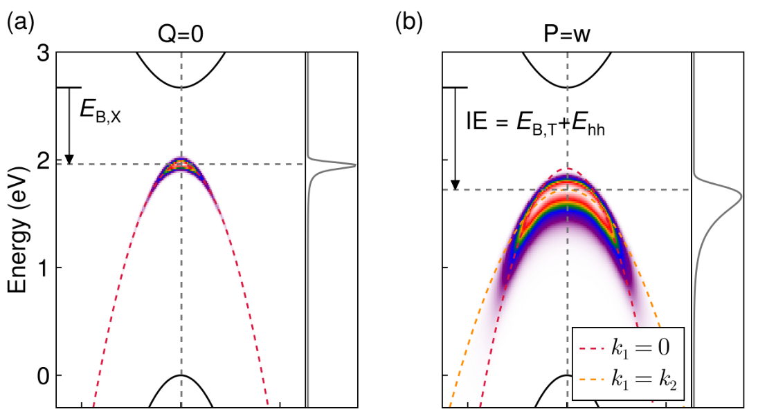
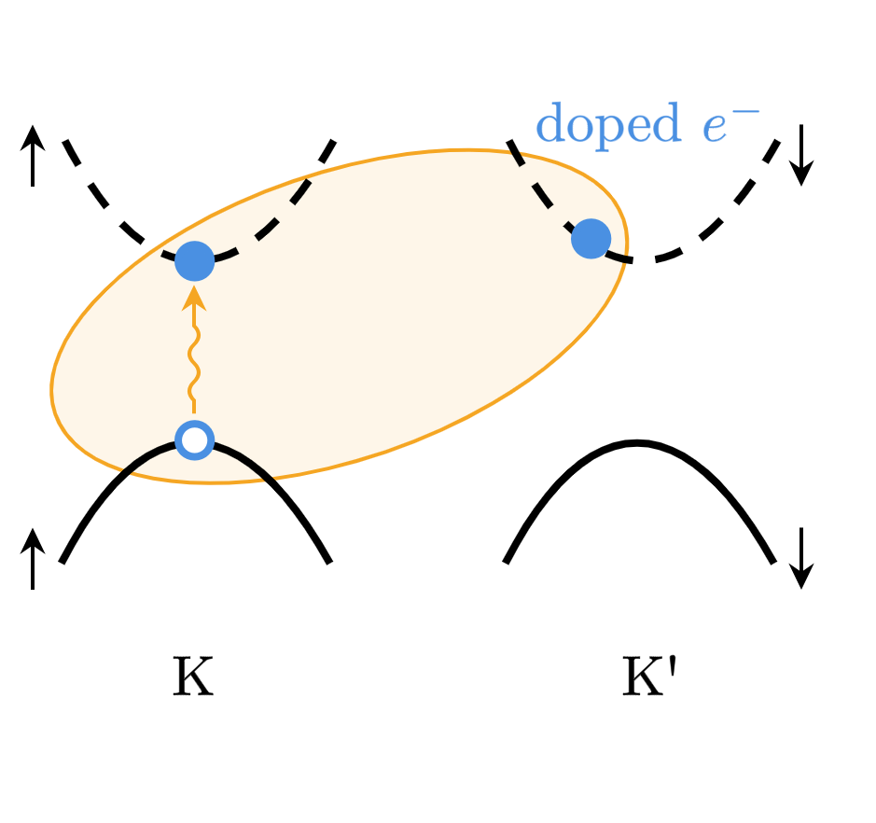
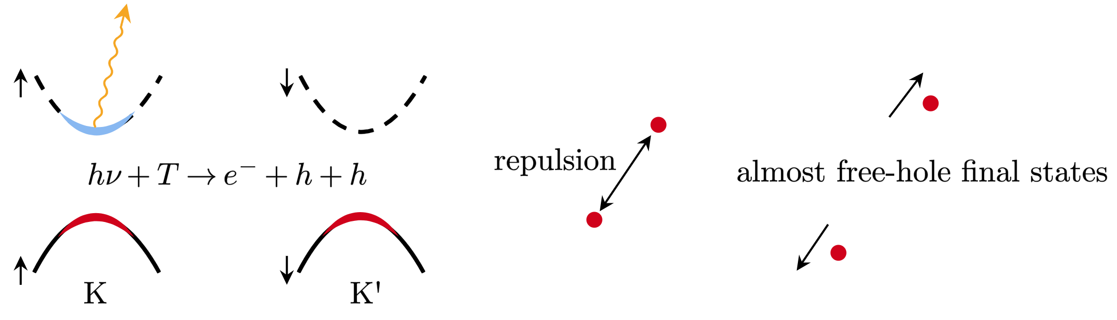
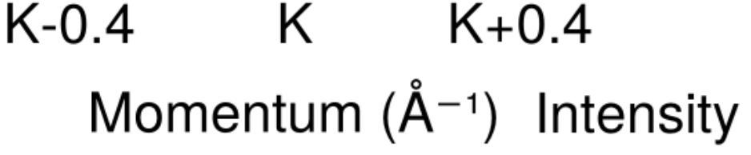
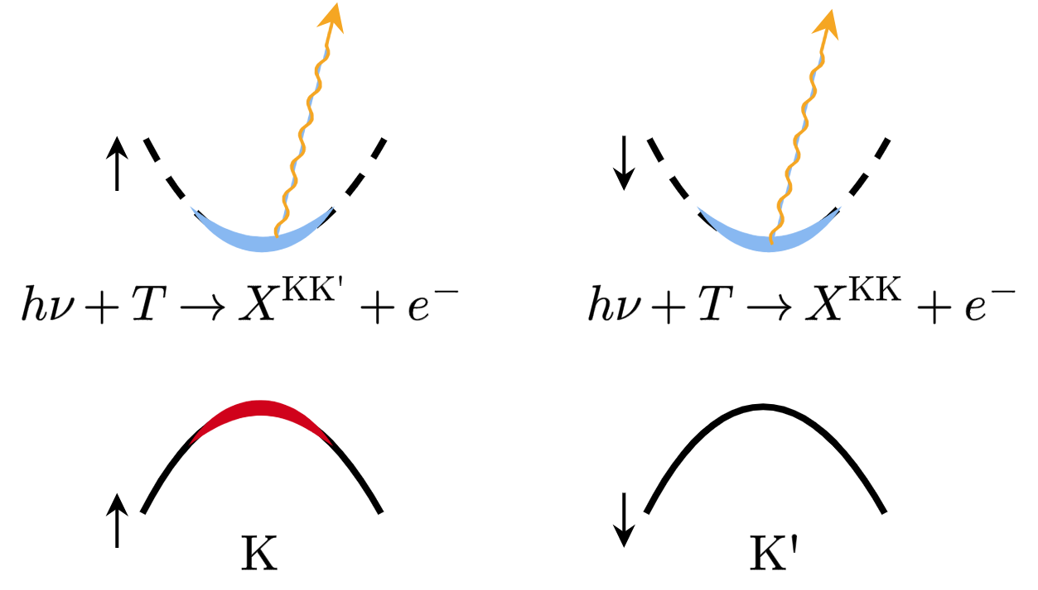
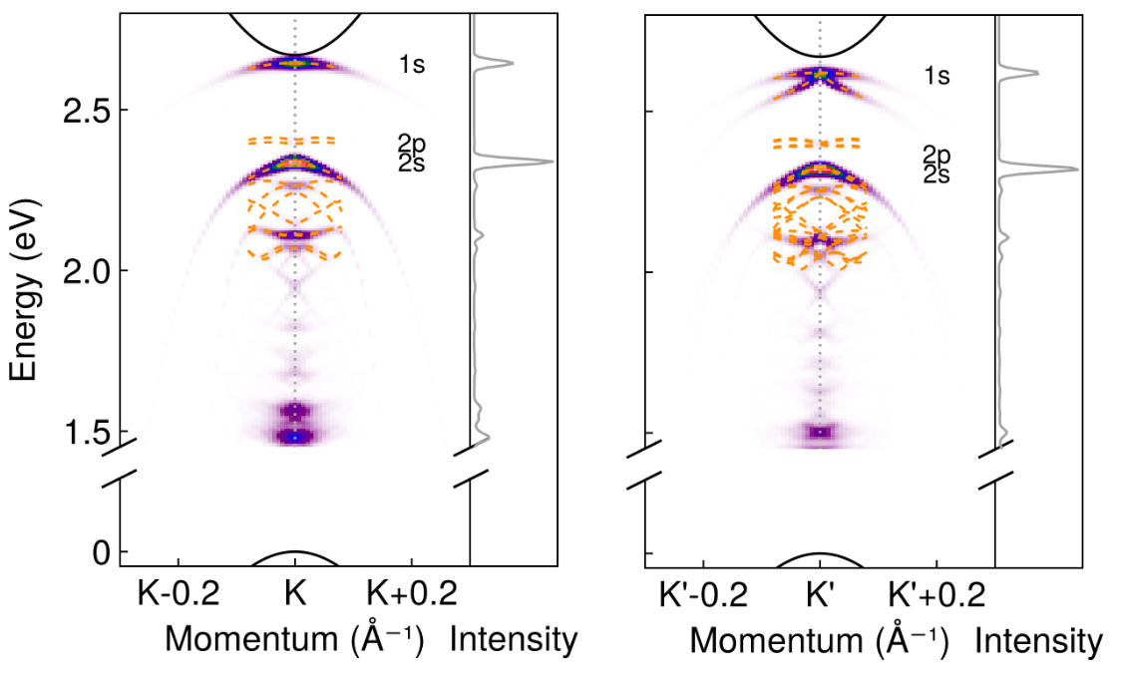
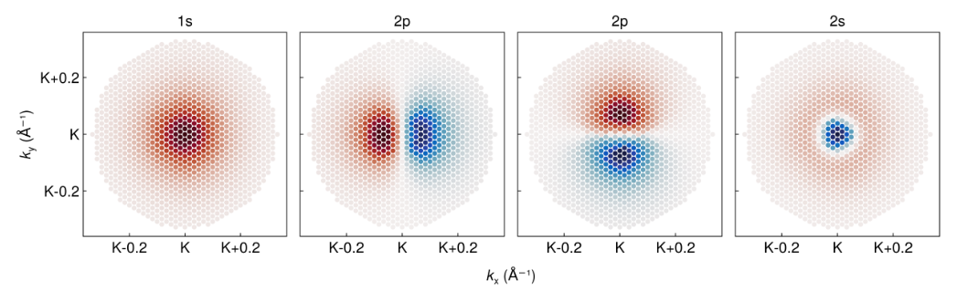
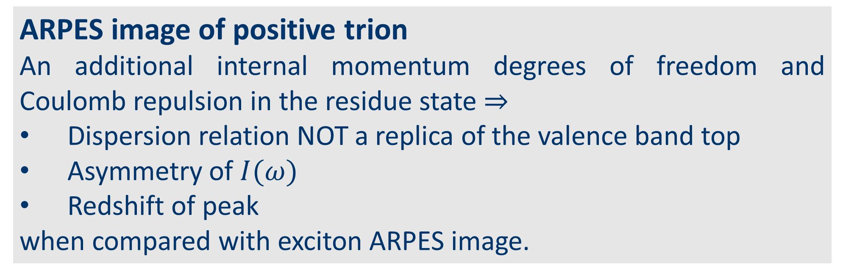
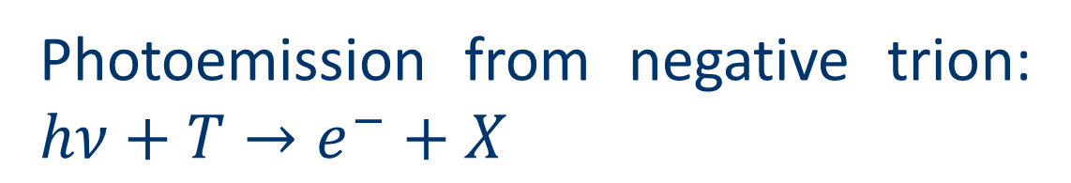
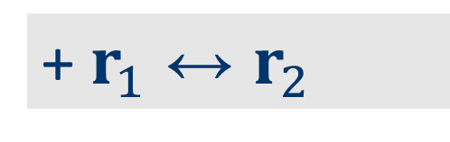

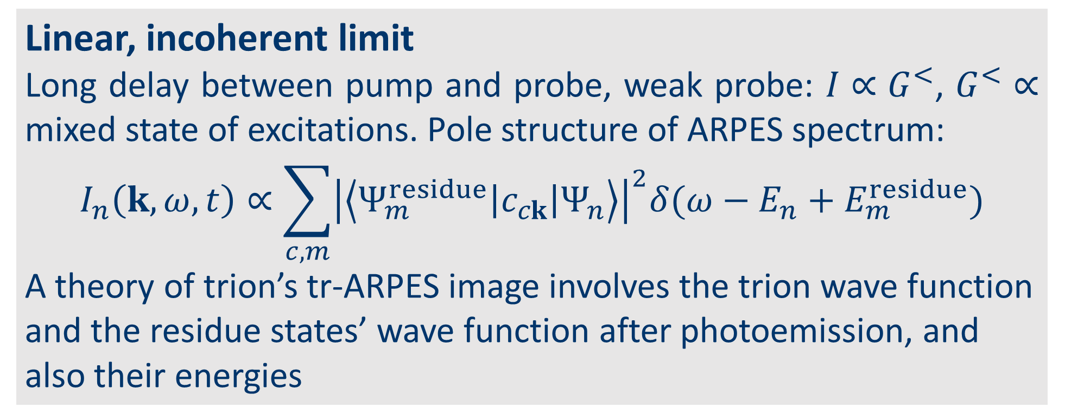
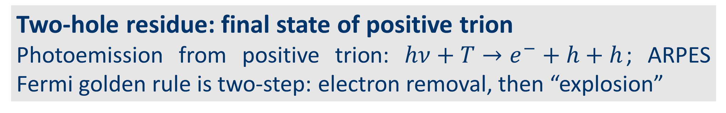

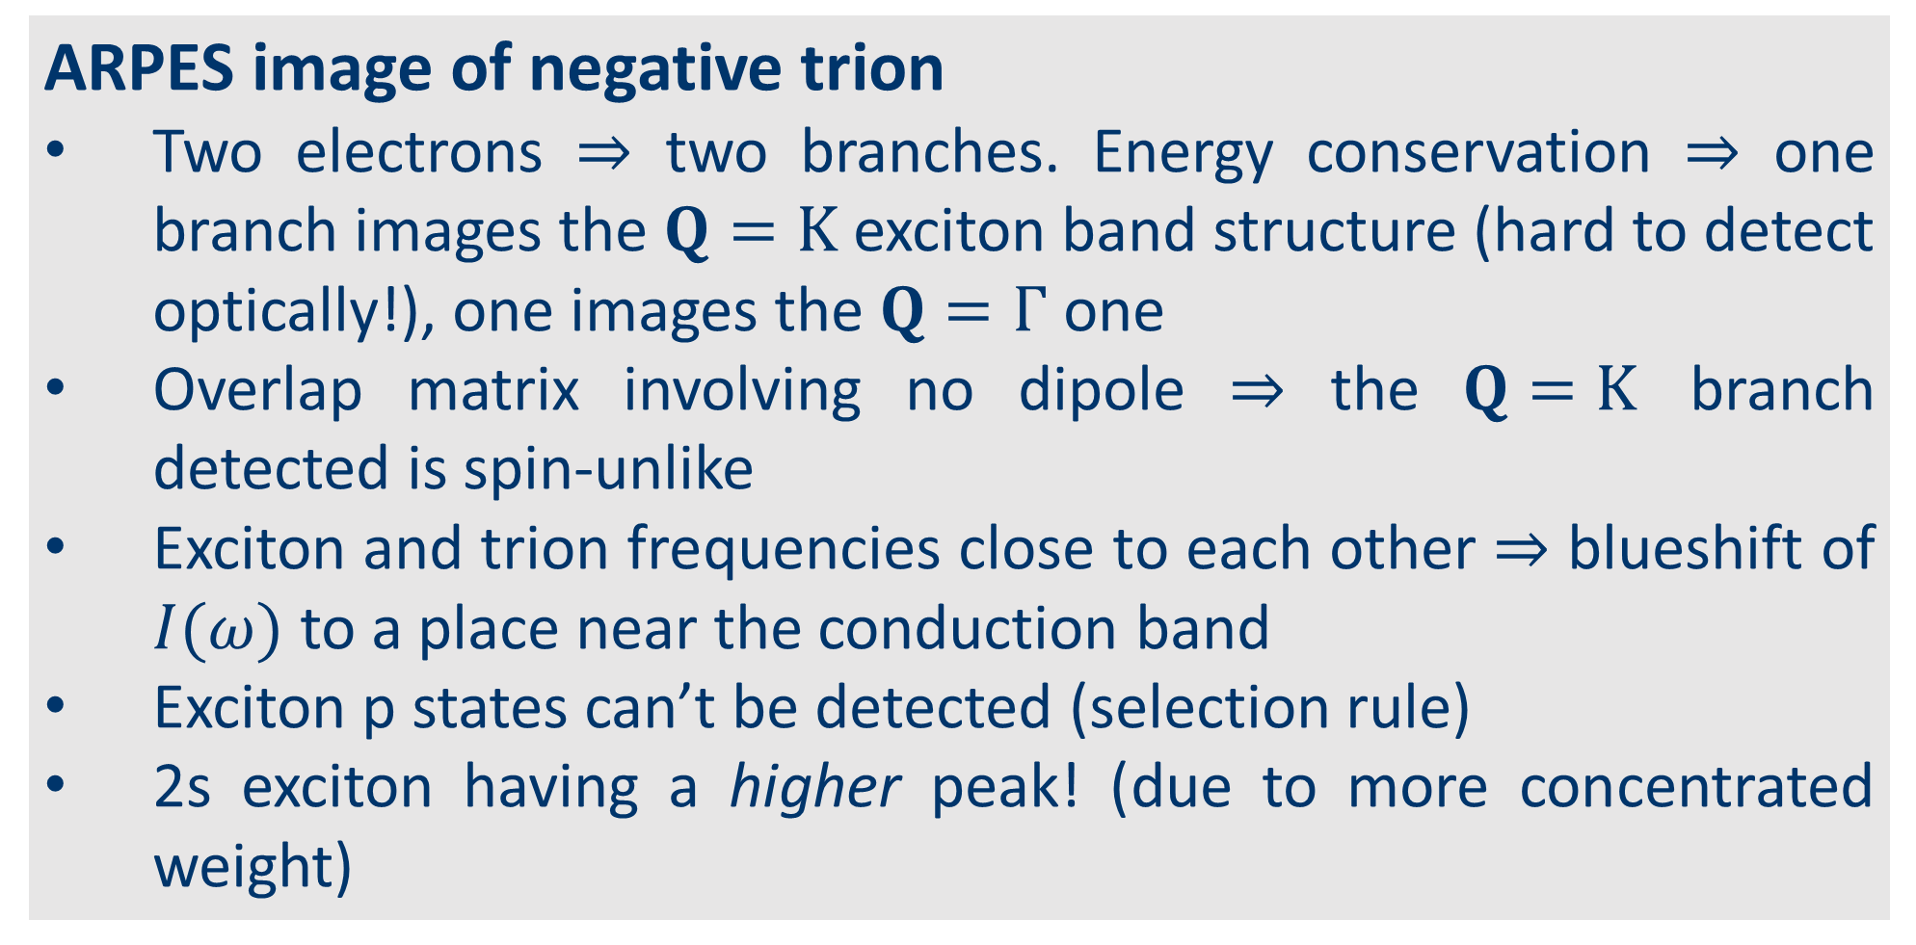
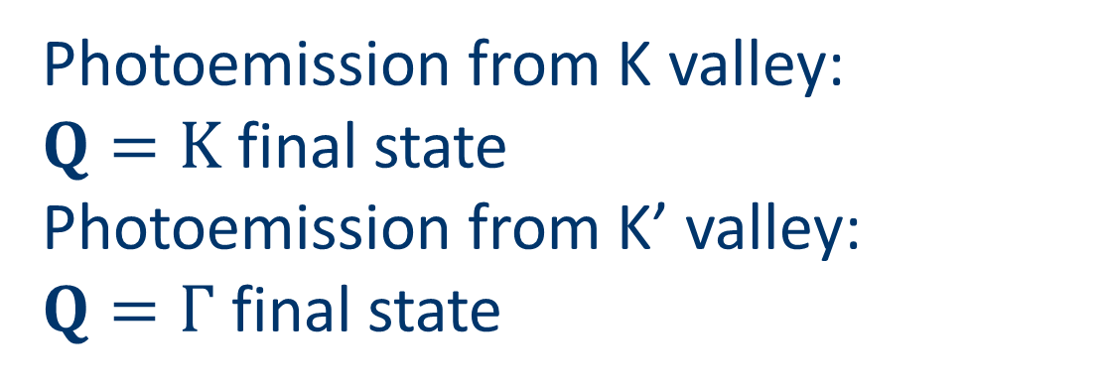
What is the signature of a trion in ARPES?
Jinyuan Wu¹, Zachary Withers², Thomas Allison², Diana Y. Qiu¹
1. Department of Materials Science, Yale University, New Haven, CT 06511, USA 2. Department of Chemistry, Stoney Brook University, Stony Brook, New York 11794, USA
Introduction
Theory of tr-ARPES for trions
Results
tr-ARPES
Time-resolved ARPES in pumped systems detects non-equilibrium electronic structure
BSE for trion
Excitonic Bethe-Salpeter equation (BSE) generalized for trions: adding e-e or h-h interaction lines
ARPES image of positive trion
An additional internal momentum degrees of freedom and Coulomb repulsion in the residue state ⇒
Dispersion relation NOT a replica of the valence band top
Asymmetry of $I(ω)$
Redshift of peak
when compared with exciton ARPES image.
Trions
Optical excitations created by pumping in doped systems allegedly creates trions.
Asymmetric photoluminescence line shape. Enough evidence?
What about tr-ARPES detection of trions?
exciton
trion
Trions in monolayer MoS₂: initial state
Existing trion BSE calculation: lowest mode is an intervalley singlet. We build two-band models for this trion structure, solved by Chandrasekhar ansatz.
+ $r_{1}↔r_{2}$
Two-hole residue: final state of positive trion
Photoemission from positive trion: $hν+T→e^{−}+h+h$; ARPES Fermi golden rule is two-step: electron removal, then “explosion”
MoS2 monolayer
Well known excitonic material
Existing exciton and trion BSE data and experimental data
Valleytronic material, spin-valley locking
Parabolic band structure near valleys
ARPES image of negative trion
Two electrons ⇒ two branches. Energy conservation ⇒ one branch images the $Q=K$ exciton band structure (hard to detect optically!), one images the $Q=Γ$ one
Overlap matrix involving no dipole ⇒ the $Q=K$ branch detected is spin-unlike
Exciton and trion frequencies close to each other ⇒ blueshift of $I(ω)$ to a place near the conduction band
Exciton p states can’t be detected (selection rule)
2s exciton having a higher peak! (due to more concentrated weight)
Theory of tr-ARPES
initial
intermediate
final
Linear, incoherent limit
Long delay between pump and probe, weak probe: $I∝G^{<}$, $G^{<}∝$ mixed state of excitations. Pole structure of ARPES spectrum:
$$I_{n}\left(k,ω, t\right)∝\sum_{c,m}{{\left|\left\langle Ψ_{m}^{residue}\left|c_{ck}\right|Ψ_{n}\right\rangle \right|}^{2}δ(ω−E_{n}+E_{m}^{residue})}$$
A theory of trion’s tr-ARPES image involves the trion wave function and the residue states’ wave function after photoemission, and also their energies
Exciton residue: final state of negative trion
Photoemission from negative trion: $hν+T→e^{−}+X$
Photoemission from K valley:
$Q=K$ final state
Photoemission from K’ valley:
$Q=Γ$ final state
References
Summary and discussion
Christopher et al. Sci. Rep. 7.1 (2017): 14062.
Perfetto, et al. PRB 94.24 (2016): 245303.
Rustagi et al. PRB 97.23 (2018): 235310.
Drüppel et al. Nat. Comm. 8.1 (2017): 2117.
Berkelbach et al. PRB 88.4 (2013): 045318.
Positive and negative trions have qualitative differences from each other and from excitons in tr-ARPES
Negative trion’s tr-ARPES signal images the exciton band structure, including parts with optically inaccessible momenta and spin structure (possible new way to see exciton bands!)
Features robust to thermalization
Generalizable to other composite excitations (and able to tell them apart)
Acknowledgement
$$Q=K$$
$$Q=Γ$$
We thank precious theoretical and experimental inputs from Tom Allison and Zach Withers.

